Slide 1
Hostel Analysis of backpacked countries
Lucas Bernal, 10.09.2023

Slide 2
What was done
Data Scrapping
Data cleaning and validation
Exploratory Data Analysis
Single variables
Multiple variables analysis
Price estimator using Machine Learning
Model development
Dorm price estimator

Slide 3
Data Scrapping

Slide 4

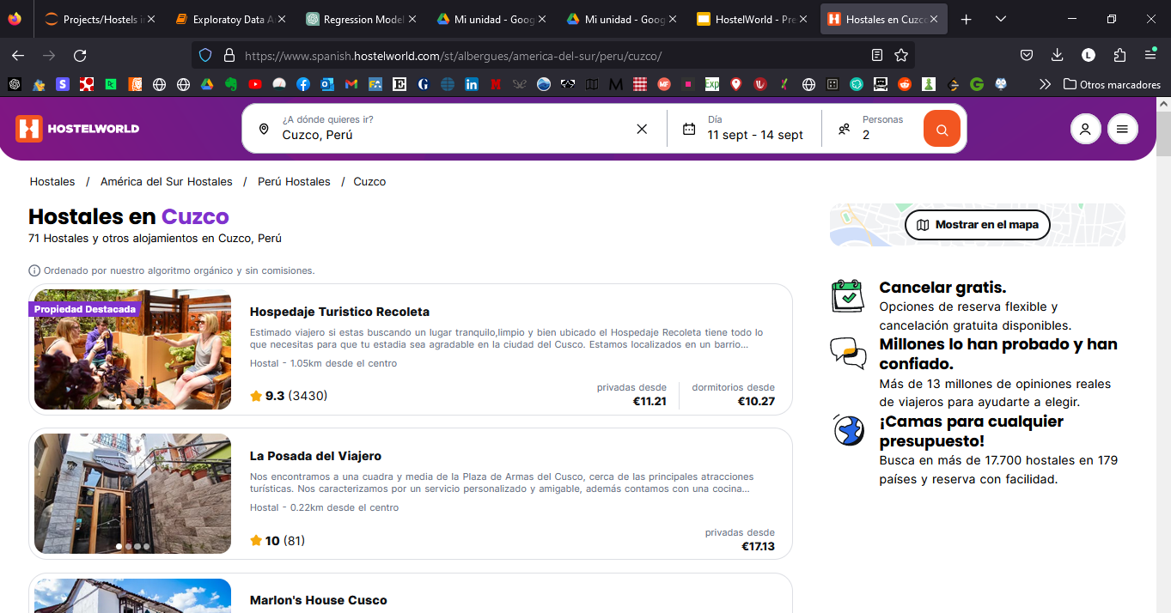
Web Scrapping from Hostelworld

Slide 5
Data Cleaning and Validation

Slide 6
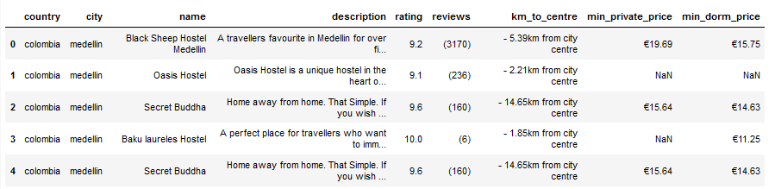
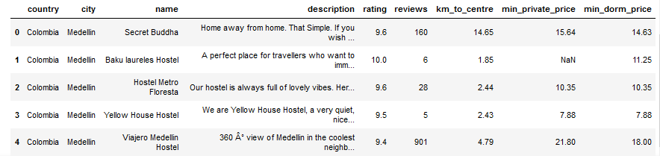
Data Cleaning and Validation
Before
After

Slide 7
Exploratory Data Analysis
Single Variable

Slide 8
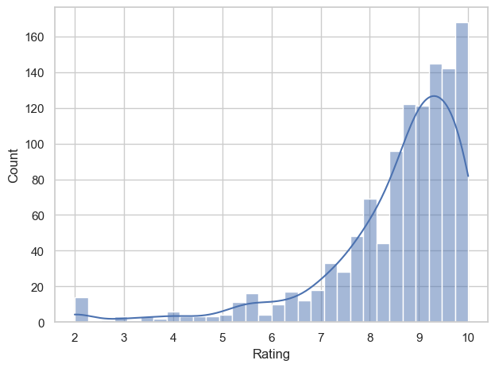
Ratings

Slide 9
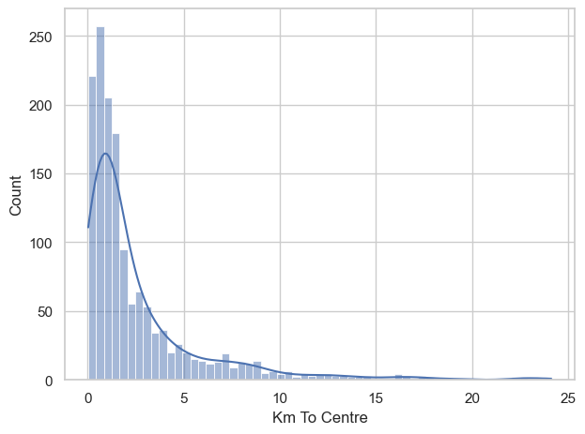
Km to centre

Slide 10
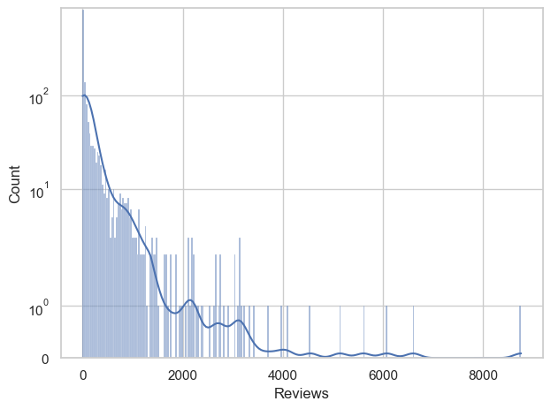
Reviews
Notes:
cambiar escala a log

Slide 11
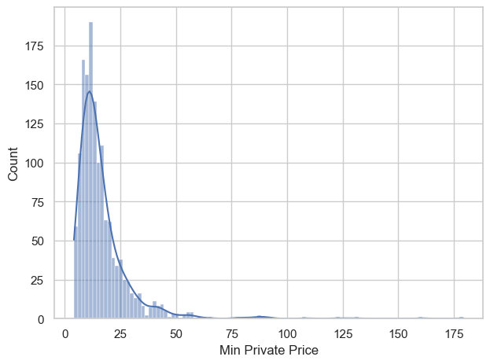
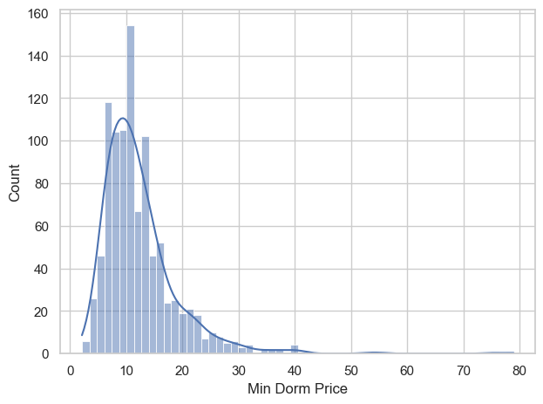
Private rooms and dorms prices

Slide 12
Exploratory Data Analysis
Multiple Variables

Slide 13
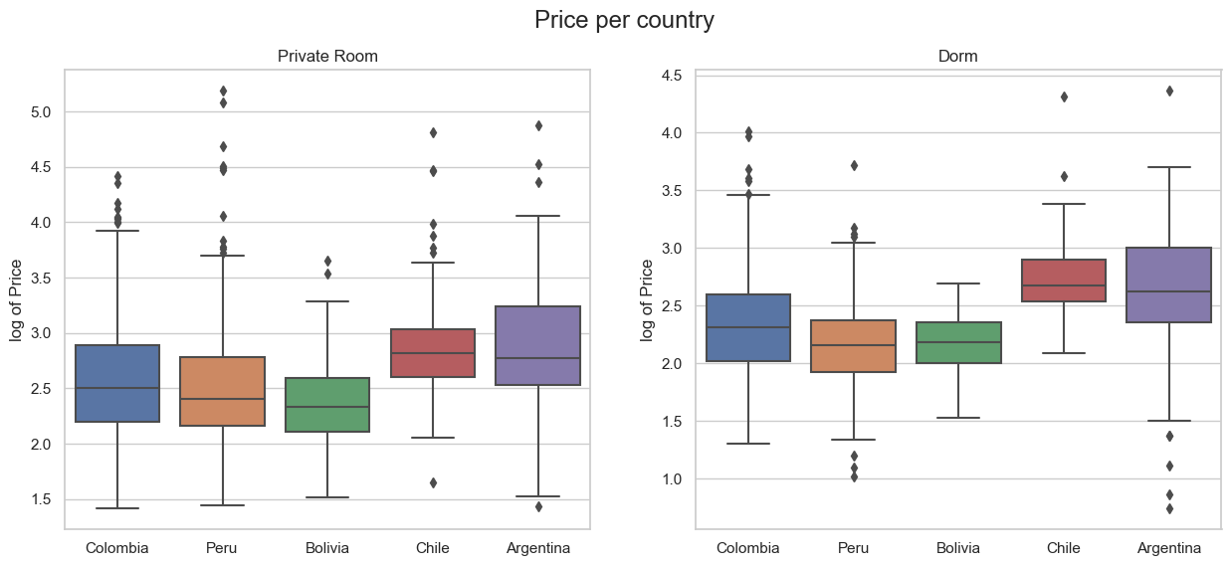
Difference in prices in private rooms is significantly different between all country pairs except for Argentina-Chile, Bolivia-Peru and Colombia-Peru. The same results were observed for the dorm prices, with the only expcetion that in this case also the difference in prices between Colombia and Peru is significant.

Slide 14
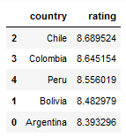
Best and worst locations for hostels - by country

Slide 15
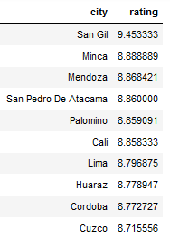
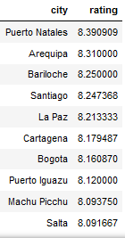
Best and worst locations for hostels - by city
Best
Worst

Slide 16
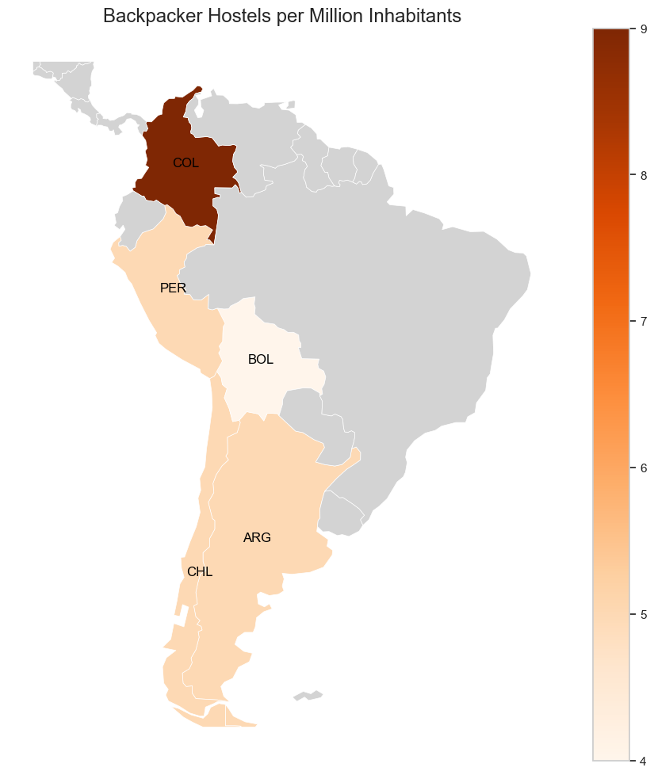

Slide 17
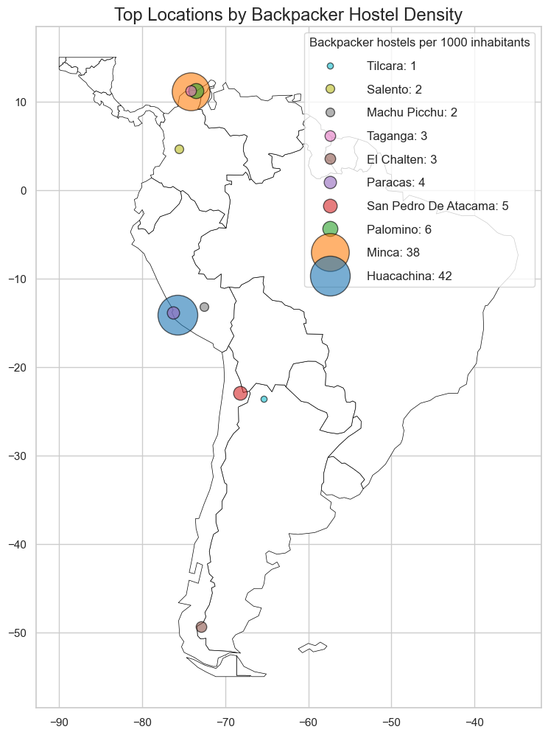

Slide 18
Price estimation using Machine Learning

Slide 19
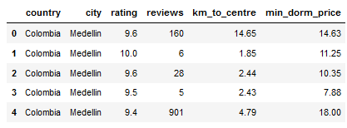
Model Development

Slide 20
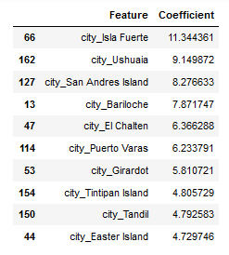
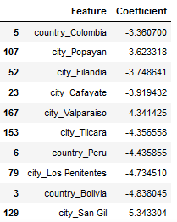
Model Development
Increase price estimation
Decrease price estimation

Slide 21

Dorm Price Estimator

Slide 22

Dorm Price Estimator

Slide 23
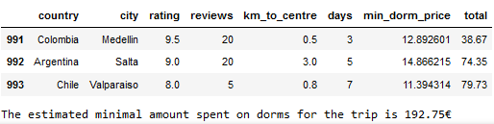
Dorm Price Estimator

